Slide 1
Top-Down Design with Functions and Classes
COS 1020 C++ Programming
AUBG COS Department
Based on chapter 3 – problem solving, abstraction and design using C++, Friedman & Koffman

Slide 2
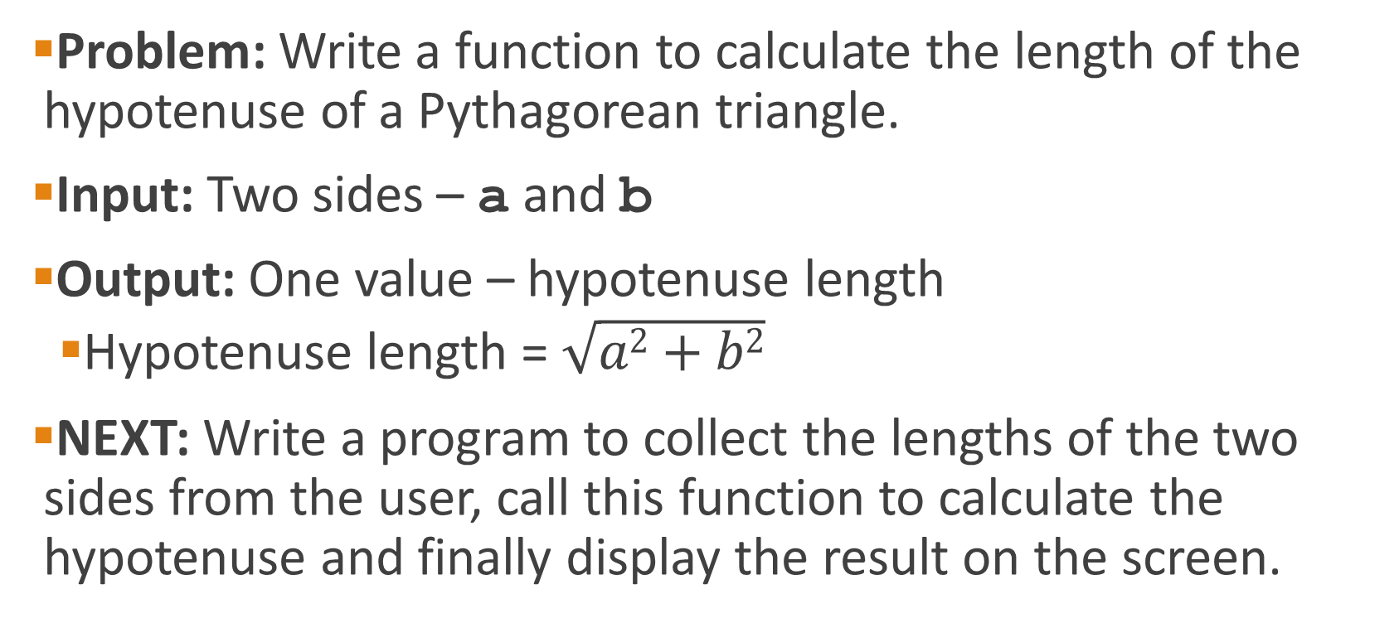
Exercise 1
Problem: Write a function to calculate the length of the hypotenuse of a Pythagorean triangle.
Input: Two sides – a and b
Output: One value – hypotenuse length
  Hypotenuse length = $\sqrt{a2+b2}$
NEXT: Write a program to collect the lengths of the two sides from the user, call this function to calculate the hypotenuse and finally display the result on the screen.

Slide 3
Exercise 2
Problem: Write two functions that compute the perimeter and area of a rectangle.
Input: Two rectangle dimensions – a and b.
Output: Two values:
  Perimeter p = 2 * a + 2 * b
  Area s = a * b
NEXT: Write a program to request two numbers from the user, execute the two functions and display the results.

Slide 4
Exercise 3
Problem:
  Implement a function to calculate the pay-raise for a person, given his annual salary. The function should receive the annual salary as its only parameter and return the computed salary for the next year.
  People earning less than $40,000 will receive a 5% raise and those earning $40,000 or more will receive a raise of $2,000 plus 2% of the amount over $40,000.
  Write a program to read a salary amount from the user and display the estimated salary for next year.

Slide 5
Exercise 4
Problem:
  Write a function that computes the factorial of a number. The factorial of a number, represented by N! is the product of that number with all numbers less than it and greater than 1.
  For example: 5! = 5 x 4 x 3 x 2
  Write a main function to test the above

Slide 6
Exercise 5
Problem:
  Write a function called sumEvenRange, which accepts as parameters the start and end of a given range, and returns the sum of all even numbers in that inclusive range.
  Write a program to ask the user for two numbers to use as ranges and display the sum computed by the above function.
  If the range is invalid (start >= end) the program should display an error.

Slide 7
Exercise 6
Problem:
  Write a function that accepts four integer parameters and returns the largest of them as a result.
  Write a program to ask the user for four integers and use the above function to get and display the maximum.

